Slide 1
Virtual LAN

Slide 2
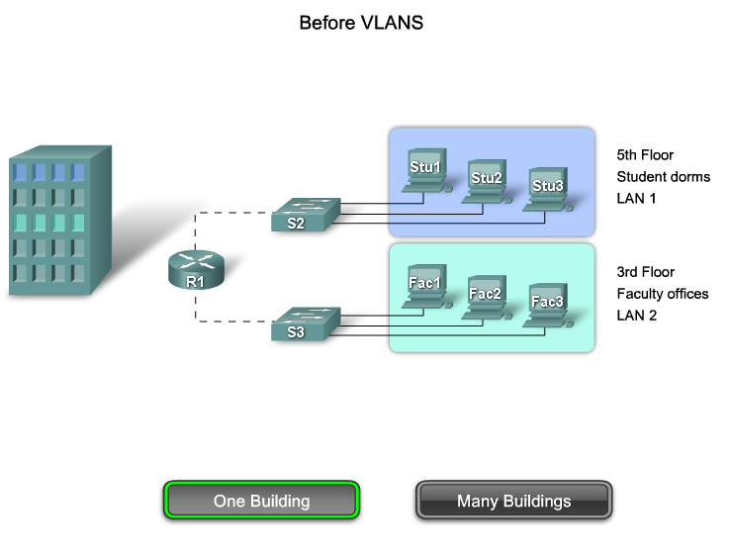
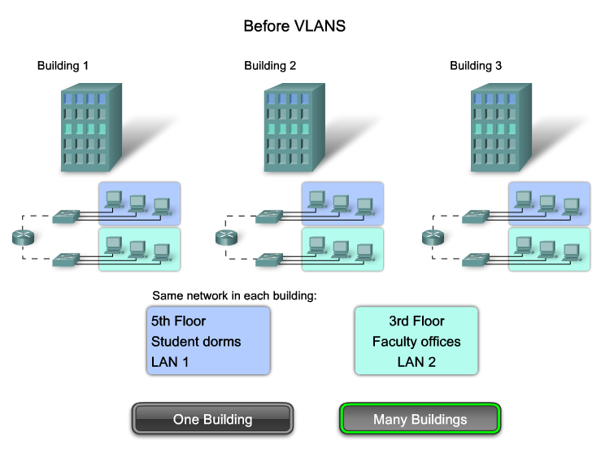
Virtual Local Area Network (VLAN)

Slide 3
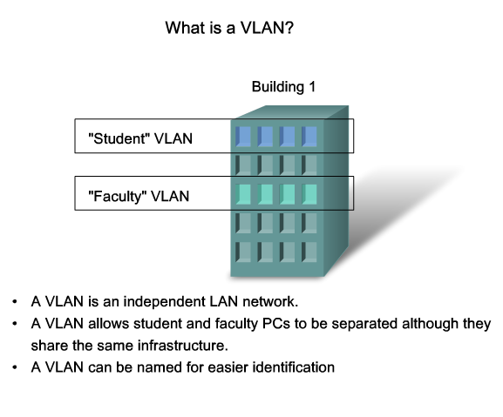
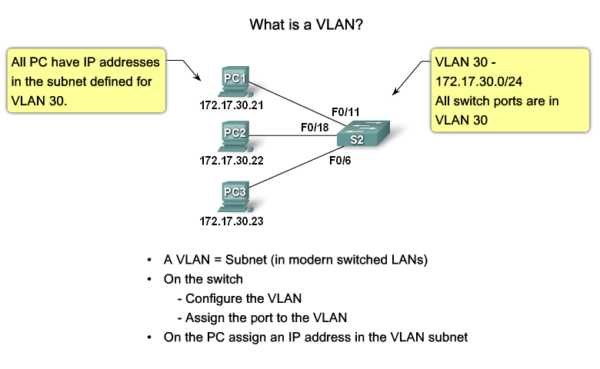
Virtual Local Area Network (VLAN)

Slide 4
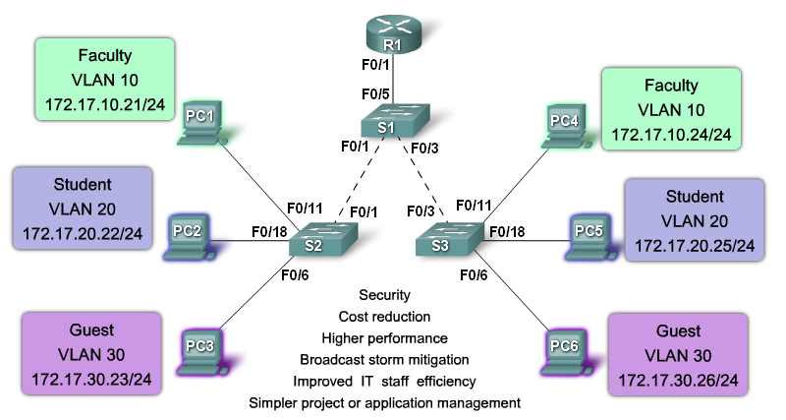
Virtual Local Area Network (VLAN)

Slide 5
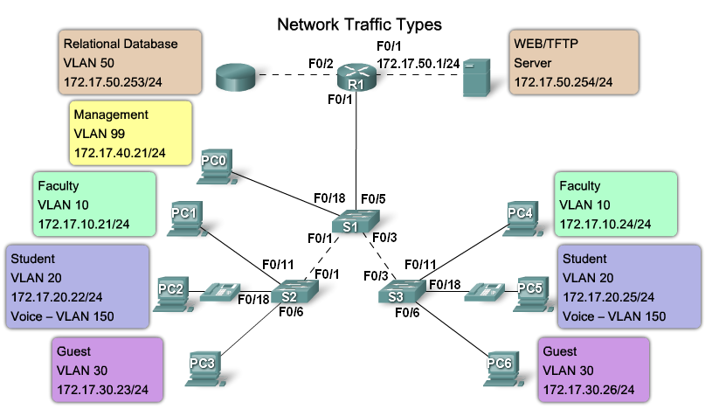
Virtual Local Area Network (VLAN)

Slide 6
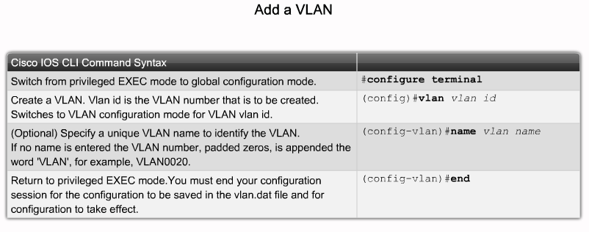
Virtual Local Area Network (VLAN)

Slide 7
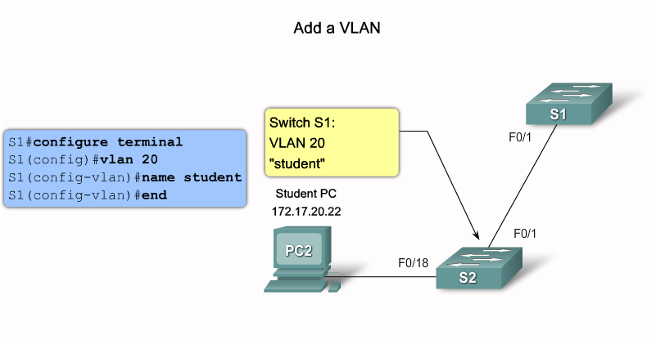
Virtual Local Area Network (VLAN)

Slide 8
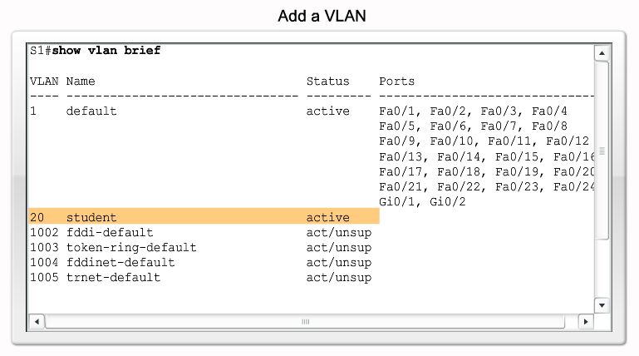
Virtual Local Area Network (VLAN)

Slide 9
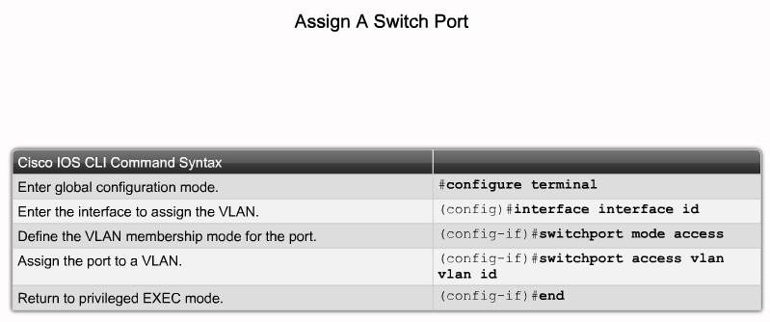
Access ports
A port which carry the data of only one VLAN

Slide 10
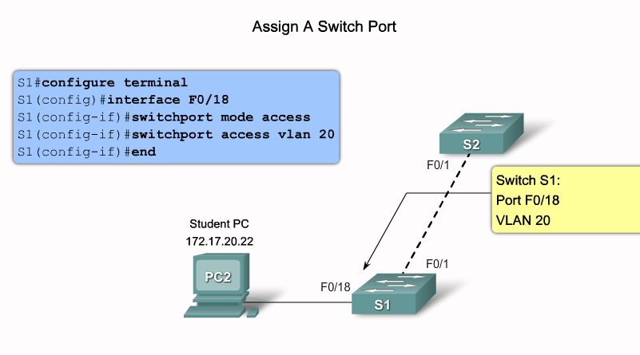
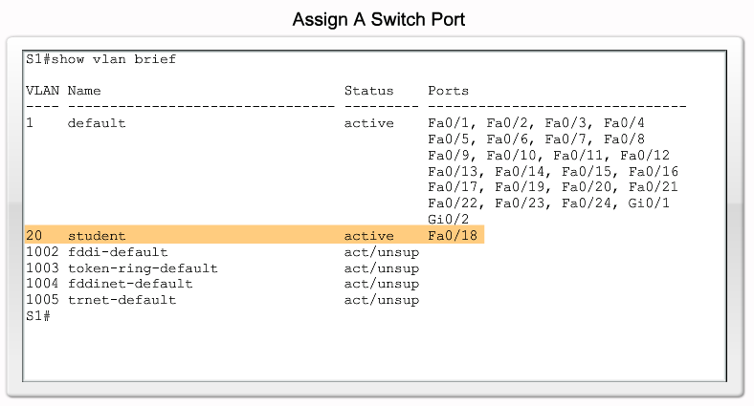
Access Ports

Slide 11
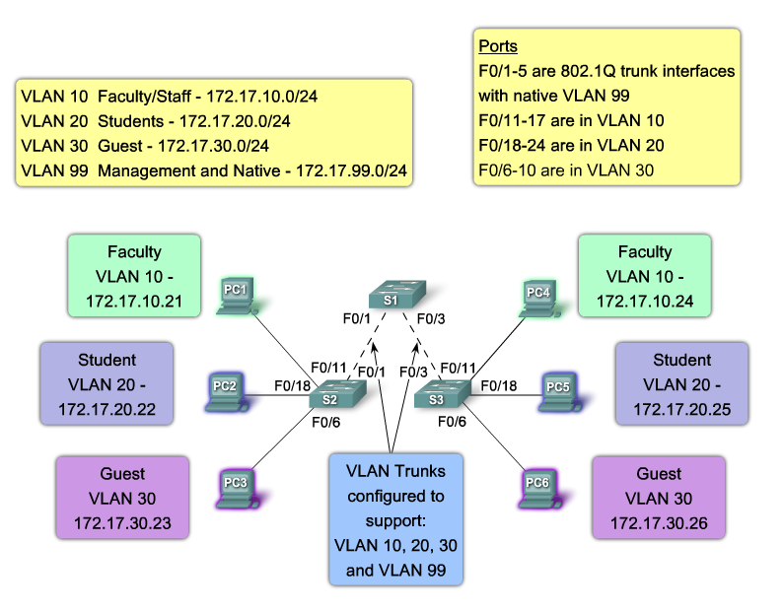
Trunk links
A port that carry traffic from different VLANs simultaneously

Slide 12
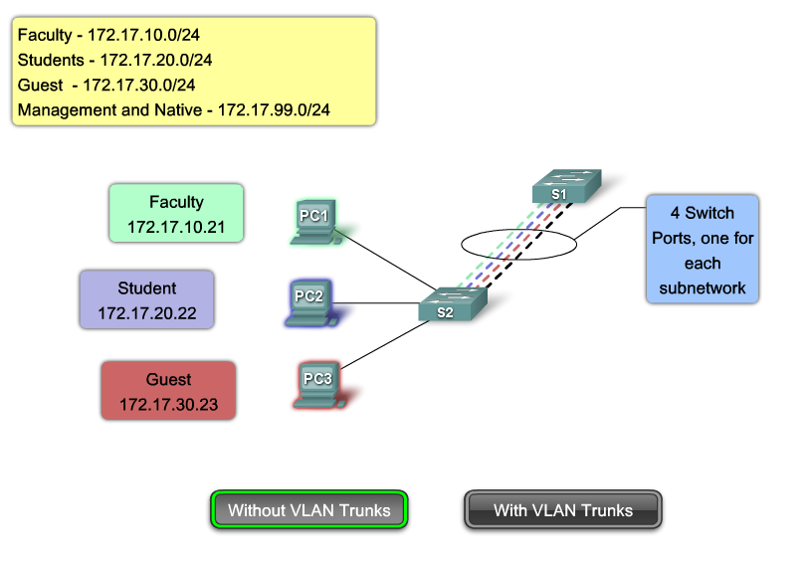
Trunk links

Slide 13
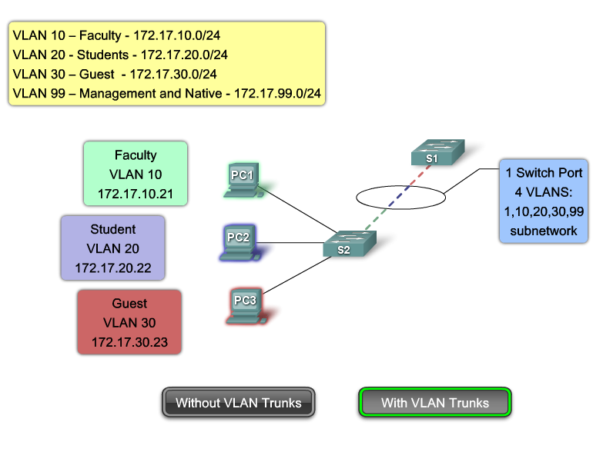
Trunk links

Slide 14
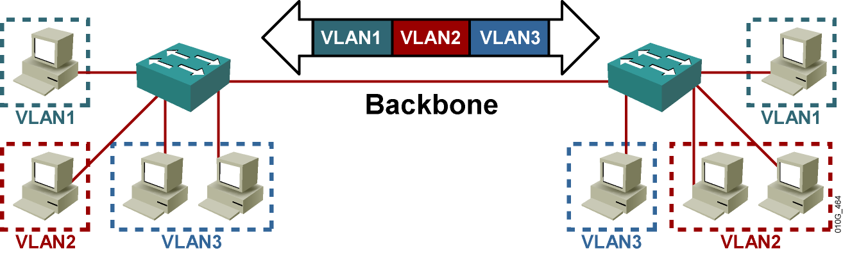
Trunk links

Slide 15
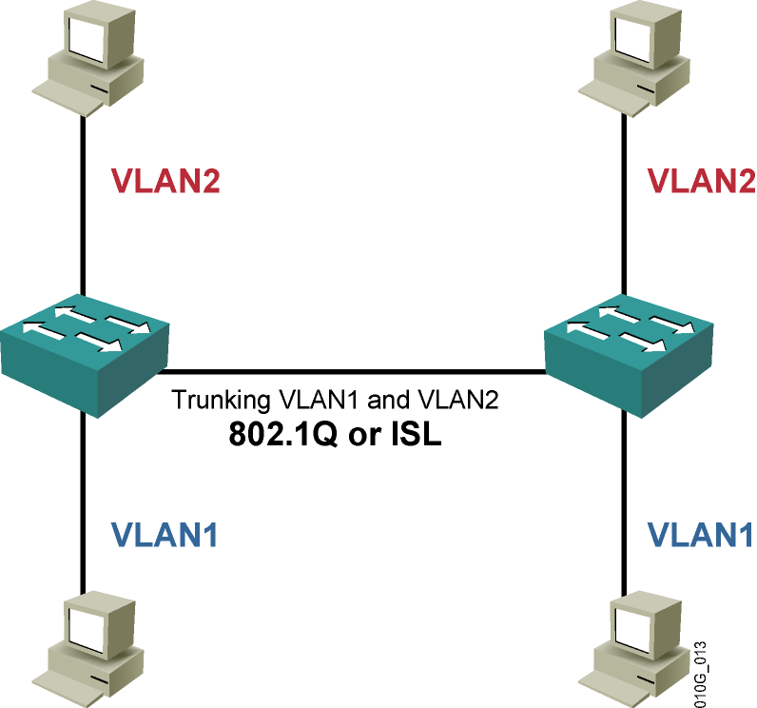
Trunk links protocols

Slide 16
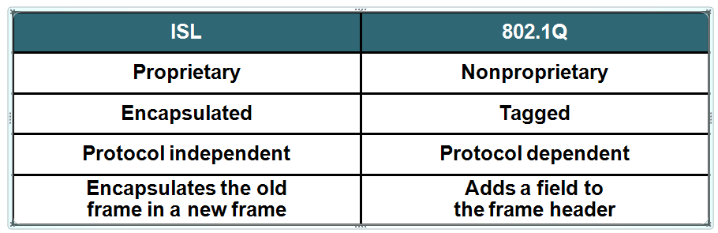
Trunk links protocols

Slide 17
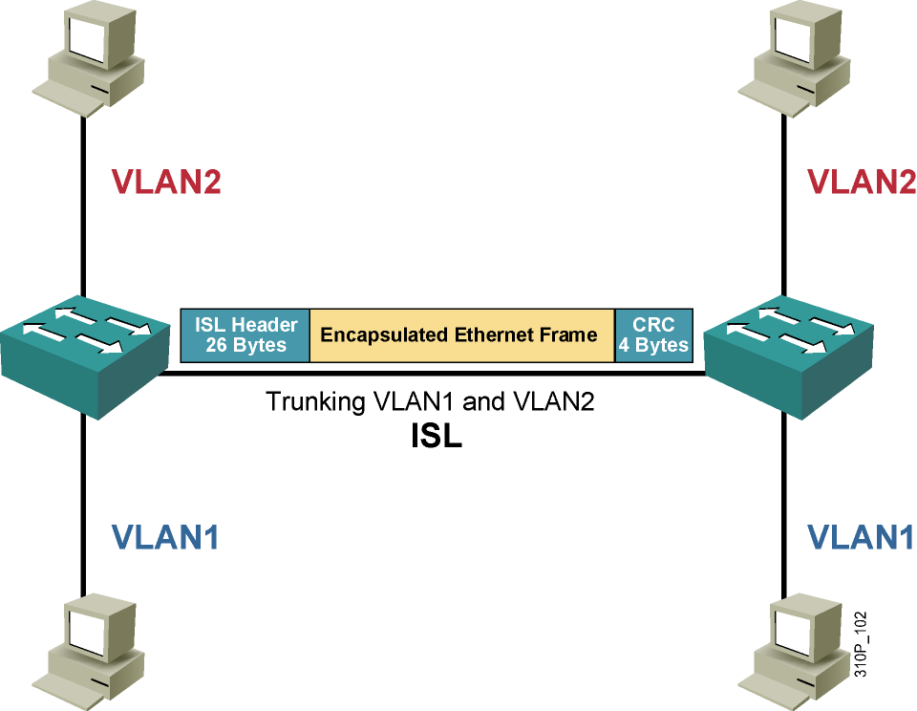
Trunking with ISL
  Is a Cisco proprietary protocol
  Supports PVST
  Uses an encapsulation process
  Does not modify the original frame

Slide 18
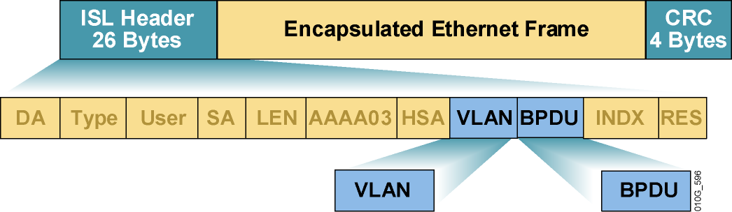
ISL Encapsulation

Slide 19
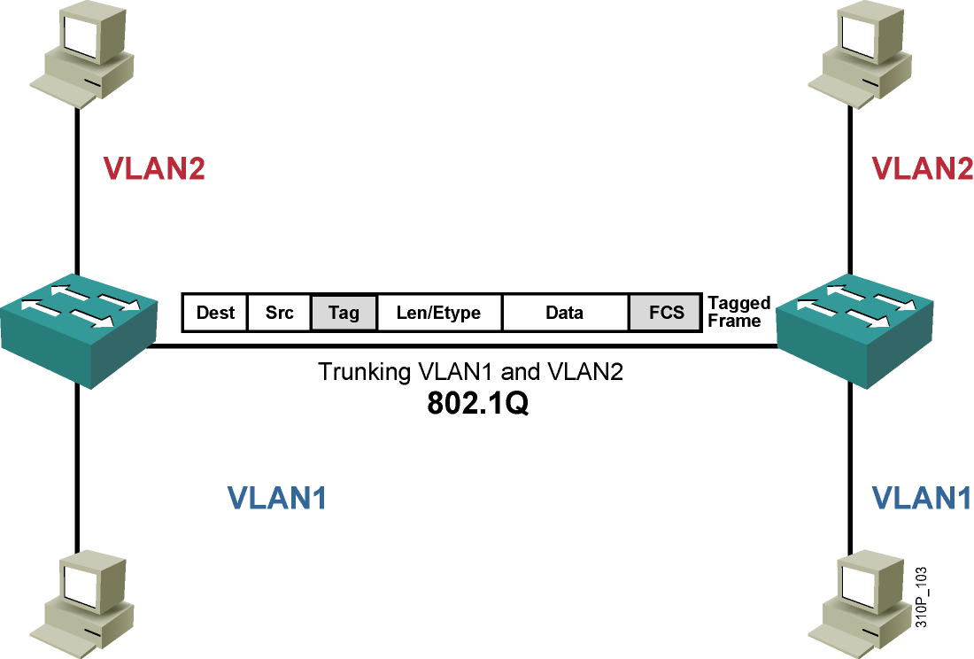
Trunking with 802.1Q
  An IEEE standard
  Adds a 4-byte tag to the original frame
  Additional tag includes a priority field
  Does not tag frames that belong to the native VLAN
  Supports Cisco IP telephony

Slide 20
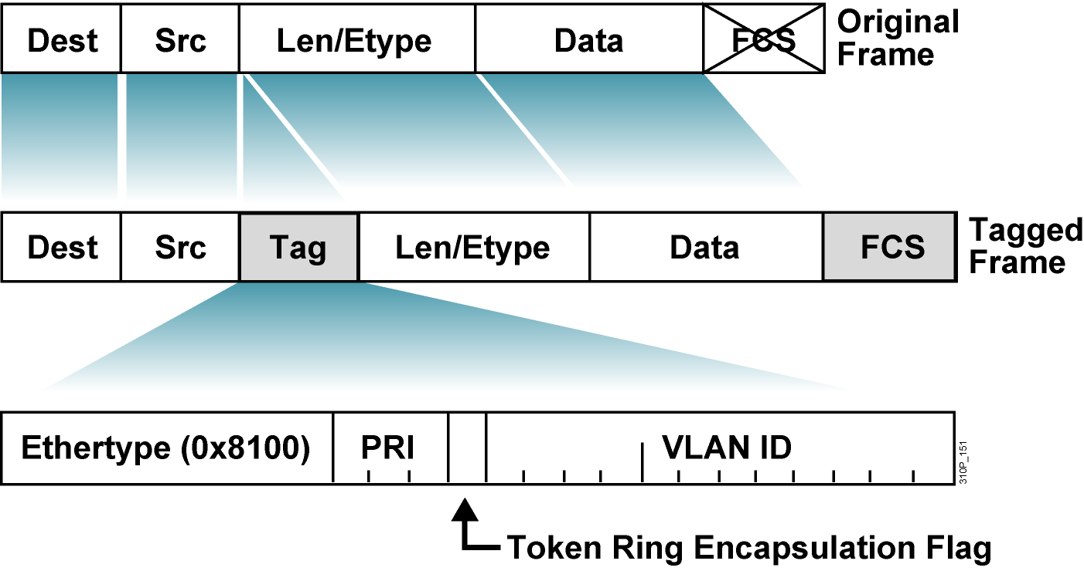
The 802.1Q Tagging Process

Slide 21
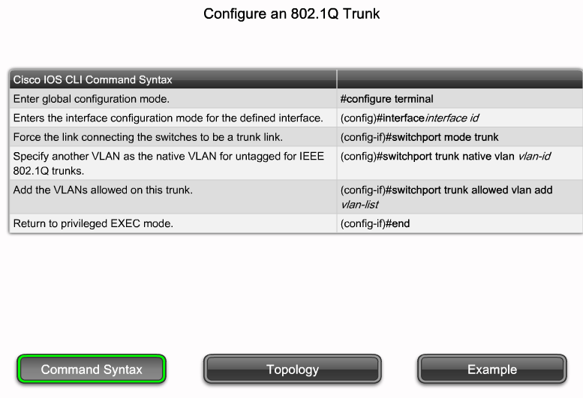
Trunk links with 802.1 q

Slide 22
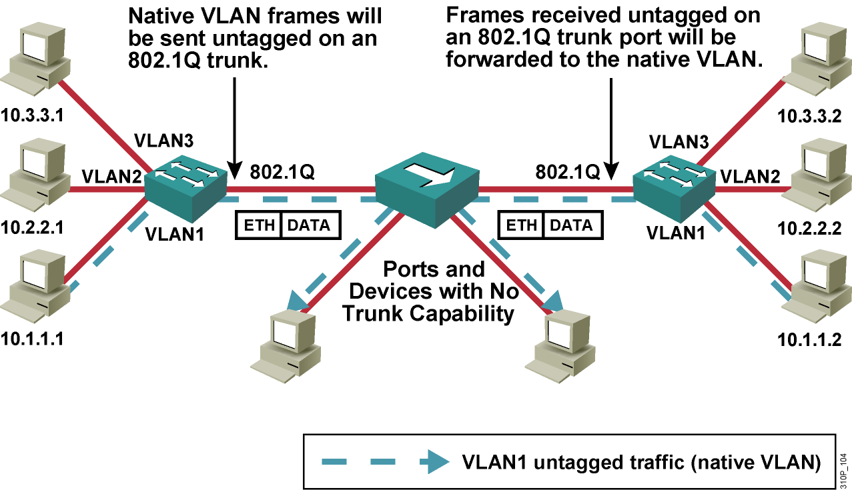
802.1Q Native VLAN
Native VLAN frames are carried over the trunk link untagged.

Slide 23
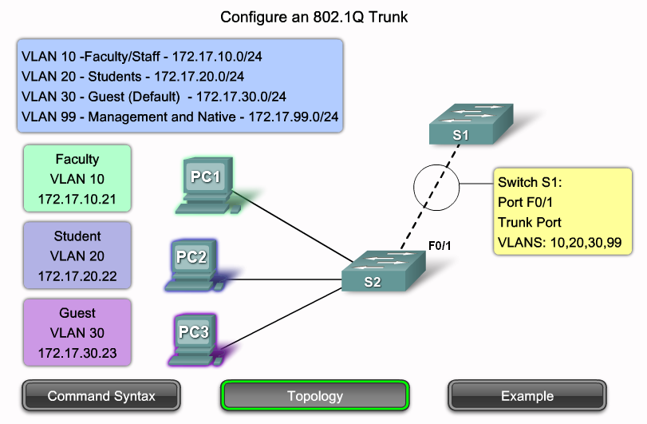
Trunk links with 802.1 q

Slide 24
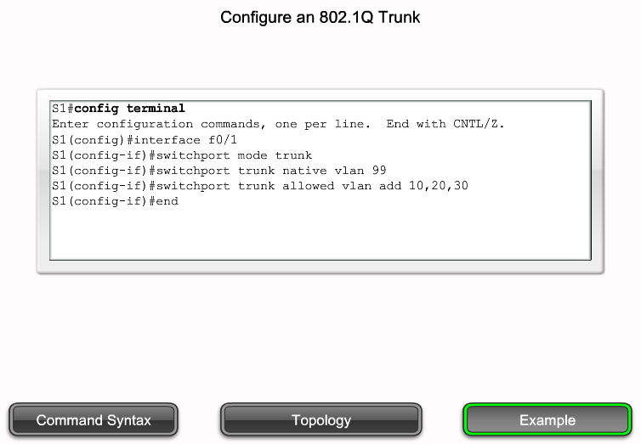
Trunk links with 802.1 q

